Slide 1
Toronto
Indentifying the best places to live

Slide 2
Business model
Target audience:
someone who already has a restaurant in a different area and would like to move to Toronto.
would be interested in opening a new restaurant in Toronto
provides a clustering of different areas based on similarities
provides information on the incomes and populations of each neighbourhood

Slide 3
Data
Data taken from the Toronto 2016 Census containing population, average income per neighbourhood etc.
Combined with the Foursquare API to collect the information on existing restaurants in these neighbourhoods which might be competitors
From the dataframes extracted, graphs produced to make the data more visual.

Slide 4
Methodology
Census data from 2016 was used to collect the income per neighbourhood from Toronto
List of names was collected
New dataset is created with the incomes and populations displayed for each neighbourhood
K-means clustering was used on the Foursquare API data for Toronto to group the neighbourhoods
Clustering method is a simple form of machine learning use, while the production of tables comes under the category of exploratory data analysis

Slide 5
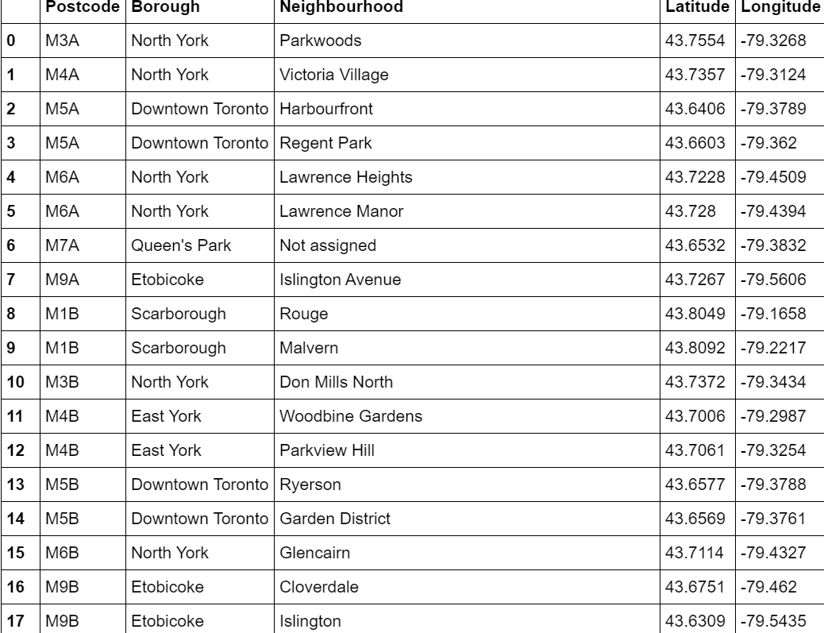

Slide 6
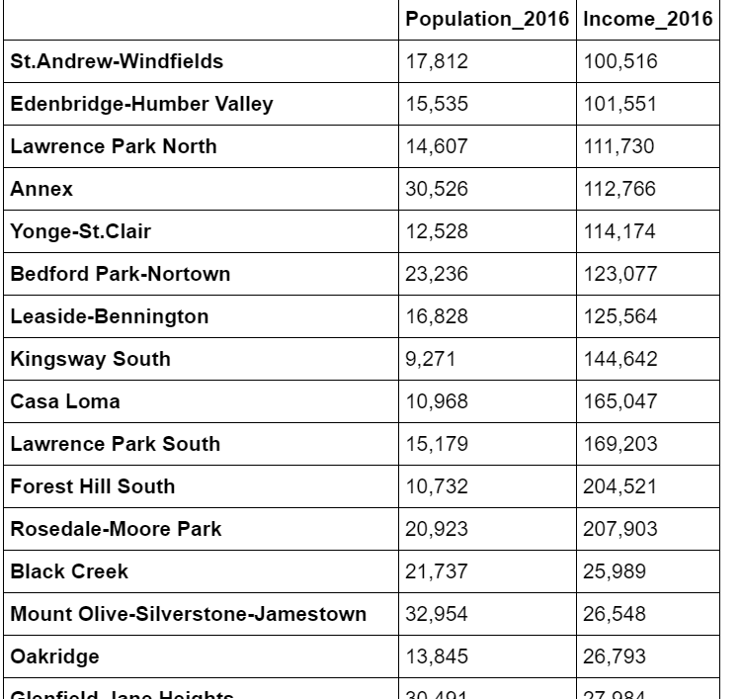

Slide 7
Results
We want to move to an area with maximal chance of a high salary with a large threshold population and minimal competition.
Most recommendable areas in terms of purely salary are Rosedale-moore Park, Forest Hill South and Lawrence Park South.

Slide 8
Conclusion
high average salary in the area may imply a high cost of living or high rent
will require more data as it will be necessary to investigate transport to ensure good transport to work is possible.

